Slide 1
Setting Up VSCode for Flask Development
A Step-by-Step Guide

Slide 2
Introduction
01

Slide 3
Why vscode and flask?
• Visual Studio Code (VSCode) is a powerful, lightweight code editor.
• Flask is a lightweight Python web framework for building web applications.
• This guide covers installing VSCode, setting up a Python environment, and running a Flask app.

Slide 4
Installing VSCode
02

Slide 5
In a web browser e.g. Chrome or MS Edge
• Download VSCode from Visual Studio Code - Code Editing. Redefined
• Choose the installer for your OS (Windows, macOS, Linux).
• Follow the installation wizard:
• Accept the license agreement.
• Choose the installation directory.
• Add VSCode to PATH (recommended for CLI access).
• Launch VSCode after installation.

Slide 6
Download Python 3.9
03

Slide 7
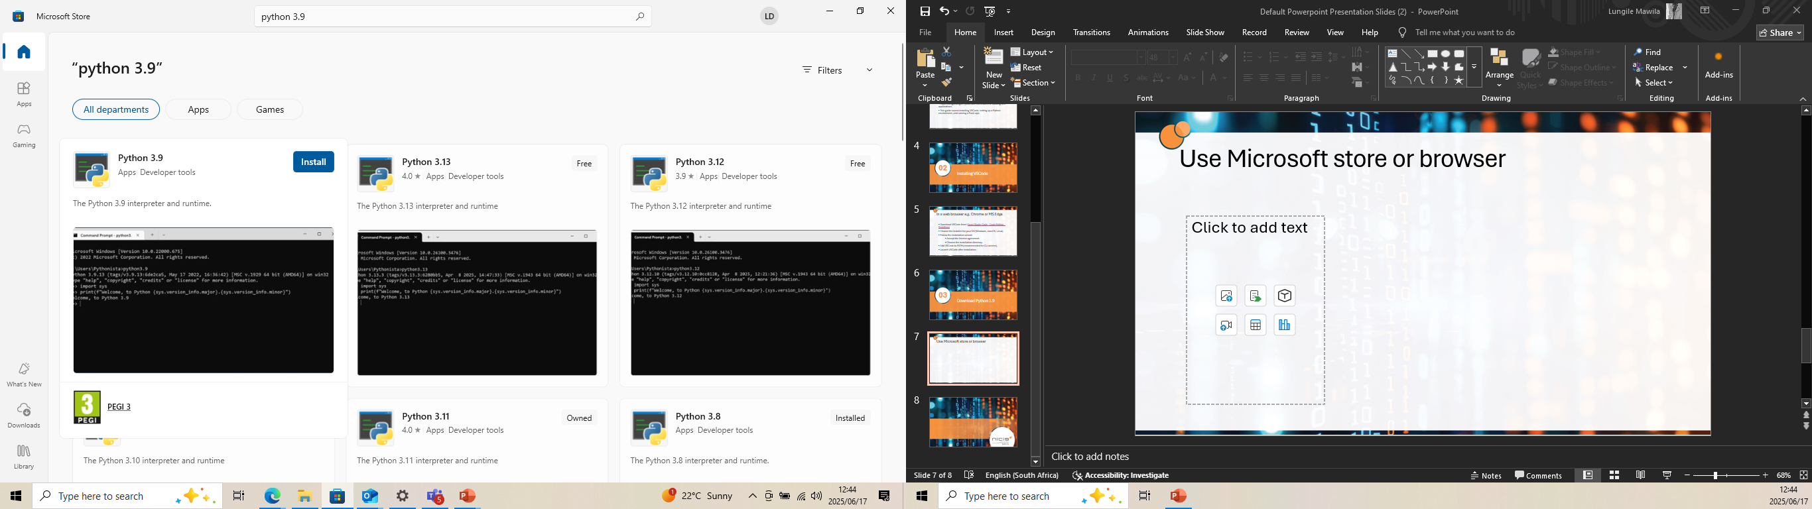
Microsoft store browser
click : https://www.python.org/ftp/python/3.9.0/python-3.9.0-amd64.exe
The file will be downloaded to your windows machine, install it and add its path to the system environment variables. Follow this YouTube tutorial to do so: https://youtu.be/91SGaK7_eeY?si=Ag-b3i1bpneURqz5
Done? Open VSCode and navigate to the terminal, and verify python installation: see the next page

Slide 8
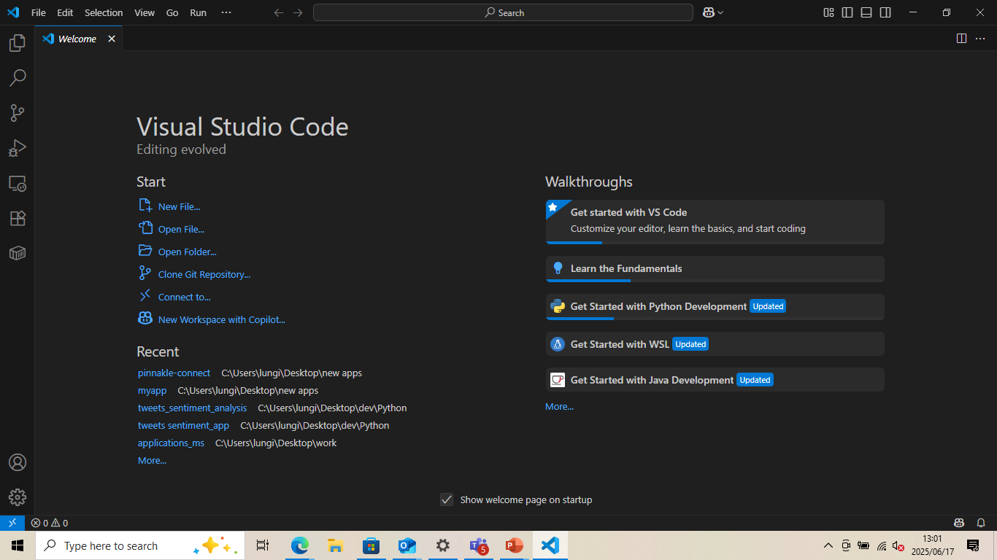
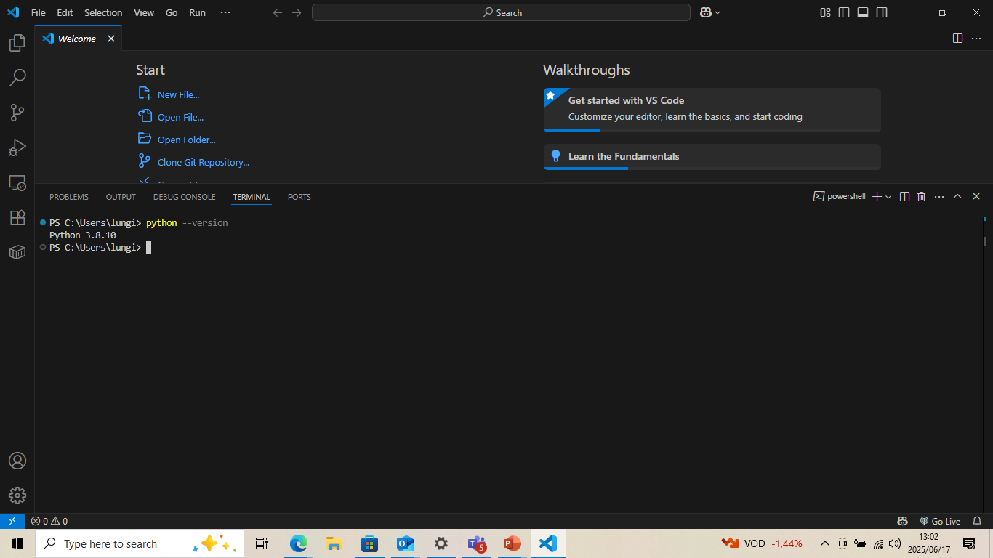
Confirm python installation on vscode
Third icon from the left, the terminal will show at the bottom of the screen
On the terminal, type: python - - version
And if it shows the version then it is successfully installed, mine is 3.8 and that is okay
Once you can see the version number, Congratulations you have made it through all the installations required for vscode and python, now lets look at how you can run flask app on your newly set environment

Slide 9
Build your first flask app
03

Slide 10
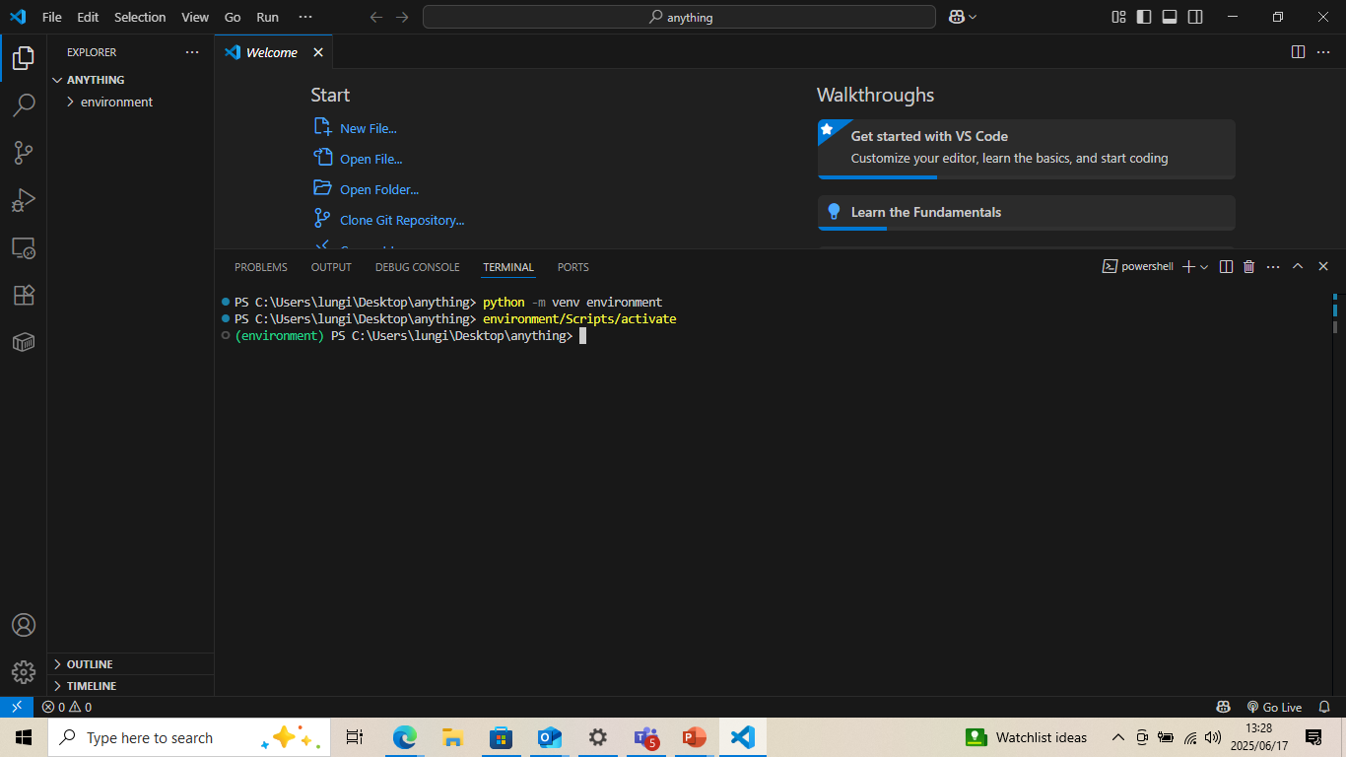
Flask app setup
Create a folder on your desktop, name it anything
Right click on the folder and click on view with vscode
In vscode, open the terminal (shown in the previous step)
Create a virtual environment, follow the screenshots below.
Commands python –m venv environment
Environment/Scripts/activate
Finally do : pip install flask

Slide 11
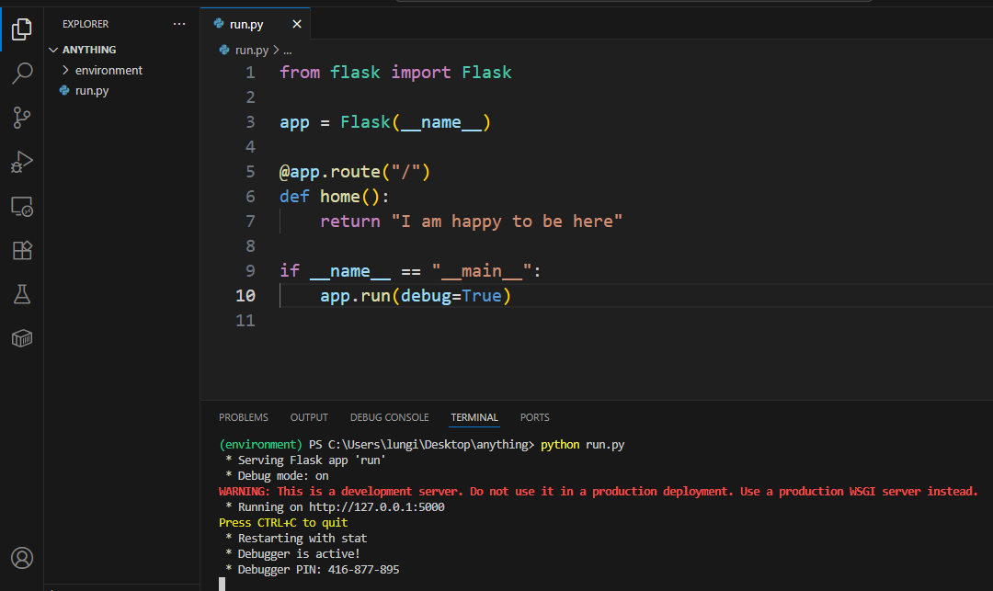
Create a web app and view on web
Create a python file on your folder and name it run.py
Code to copy
from flask import Flask
app = Flask(__name__)
@app.route("/")
def home():
return "I am happy to be here"
if __name__ == "__main__":
app.run(debug=True)
On vscode, on the EXPLORER, click on new file and type run.py
A python file will be opened to you, copy and paste the following code to it and save the file
On the terminal, type python run.py
Click on the link on the terminal
App running on
http://127.0.0.1:5000

Slide 12
Well-done on getting started with flask development on vscode

